Slide 1
CSE 3400 - Introduction to Computer & Network Security (aka: Introduction to Cybersecurity) Lecture 8 Shared Key Protocols – Part I
Ghada Almashaqbeh
UConn
From Textbook Slides by Prof. Amir Herzberg
UConn

Slide 2
Outline
Modeling cryptography protocols.
Session or record protocols.
Entity authentication protocols.
2

Slide 3
Modeling Cryptographic Protocols
A protocol is a set of PPT (efficient) functions
Each receiving (state, input), outputting (state, output)
Two (or more) parties, each has its own state
Including Init, In, [and if needed Wakeup] functions
And task-specific functions, e.g., Send
Adversary can invoke any function, handle outputs
The execution process is a series of function invocations based on which the protocol proceeds.
Our discussion (from here) is mostly informal
Definitions of protocols, execution, goals are hard
Focus on shared-key, two-party protocols, MitM adversary
3
Notes:
In this lecture we focus on shared-key protocols

Slide 4
Record Protocols Secure communication between two parties using shared keys.

Slide 5
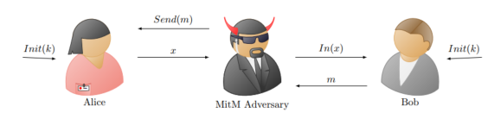
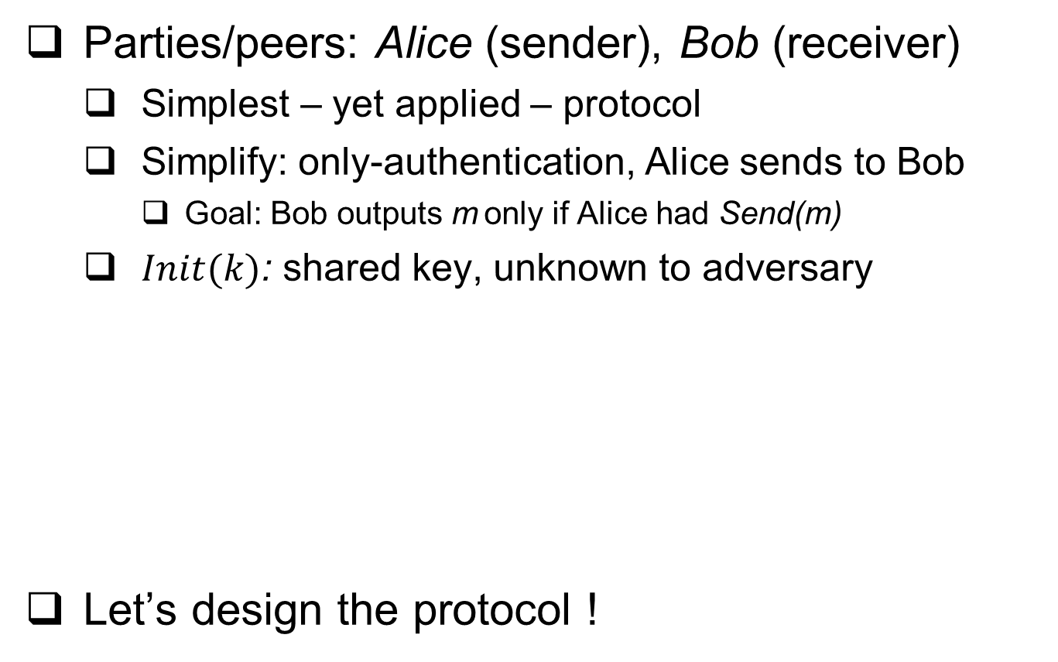
Two-party, shared-key Record protocol
Parties/peers: Alice (sender), Bob (receiver)
Simplest – yet applied – protocol
Simplify: only-authentication, Alice sends to Bob
Goal: Bob outputs m only if Alice had Send(m)
$Init(k)$: shared key, unknown to adversary
Let’s design the protocol !
5

Slide 6

Design of Two-party, shared-key Record protocol
Design: define the protocol functions
$Init(k)$ [Initialize Alice/Bob with secret key k]
$Send(m)$: Alice sends message m (to Bob)
$In(x)$ : Bob receives x from adversary

Slide 7

Design of Two-party, shared-key Record protocol
Design: define the protocol functions
Init(k) [Initialize Alice/Bob with secret key k]
$\{s.k ← k; \}$
Save received key $k$ in state-variable $s.k$ (part of $s$)
$Send(m)$: Alice sends message m (to Bob)
$In(x)$: Bob receives x from adversary

Slide 8
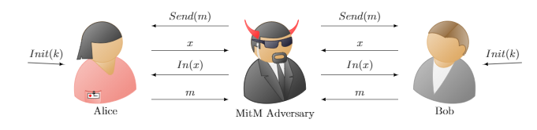
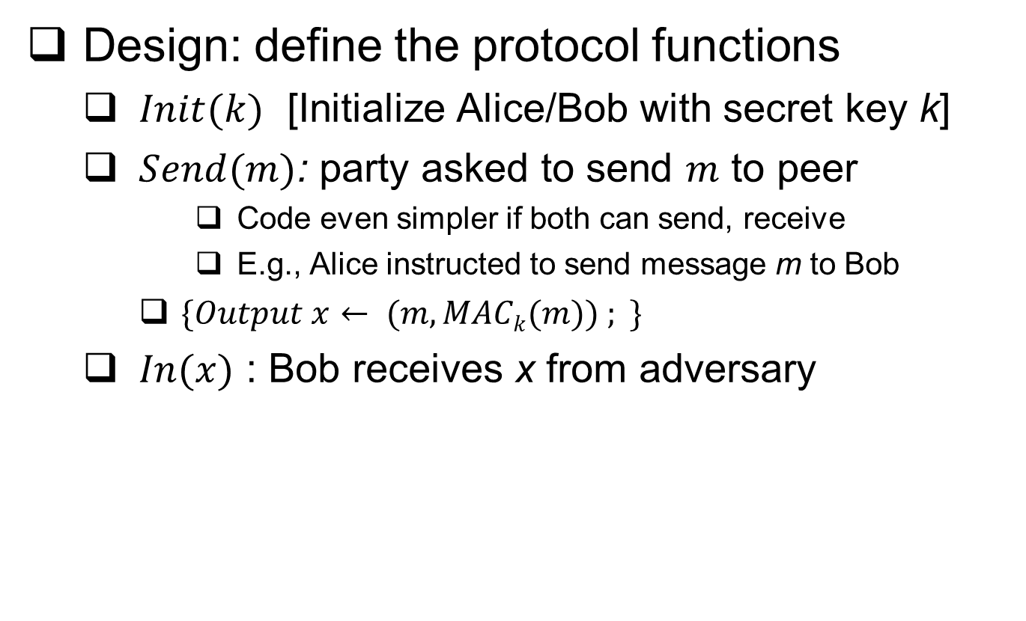
Design of Two-party, shared-key Record protocol
Design: define the protocol functions
$Init(k)$ [Initialize Alice/Bob with secret key k]
$Send(m)$: party asked to send $m$ to peer
Code even simpler if both can send, receive
E.g., Alice instructed to send message m to Bob
$\{Output x← (m, MACk(m)) ; \}$
$In(x)$ : Bob receives x from adversary

Slide 9

Design of Two-party, shared-key Record protocol
Design: define the protocol functions
$Init(k)$ [Initialize Alice/Bob with secret key k]
$Send(m)$: Party sends message m to peer
$In((m,σ))$ : Party receives $(m,σ)$ from adversary
$\{Output m$ if $(σ=MACk(m)) ;\}$
Output the message only if validated Ok

Slide 10
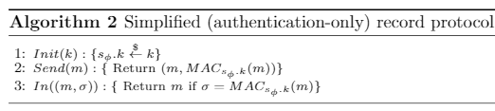

Design of Two-party, shared-key Record protocol
Design: define the protocol functions
$Init(k)$ [Initialize Alice/Bob with secret key k]
$\{s ← k; \}$[Save received key k in the state s ]
$Send(m)$: Alice sends message m (to Bob)
$\{Output x= (m, MACk(m)) ; \}$
$In((m,σ))$ : Bob receives $(m,σ)$ from adversary
$\{Output m$ if $(σ=MACk(m)) ;\}$

Slide 11
Two-party, shared-key Record protocol
Design has many simplifications, easily avoided:
Only message authentication
No confidentiality!
Only ensure same message was sent
Allow duplication, out-of-order, `stale’ messages, losses
Also: no retransmissions, compression, …
To add confidentiality: use encryption
11

Slide 12
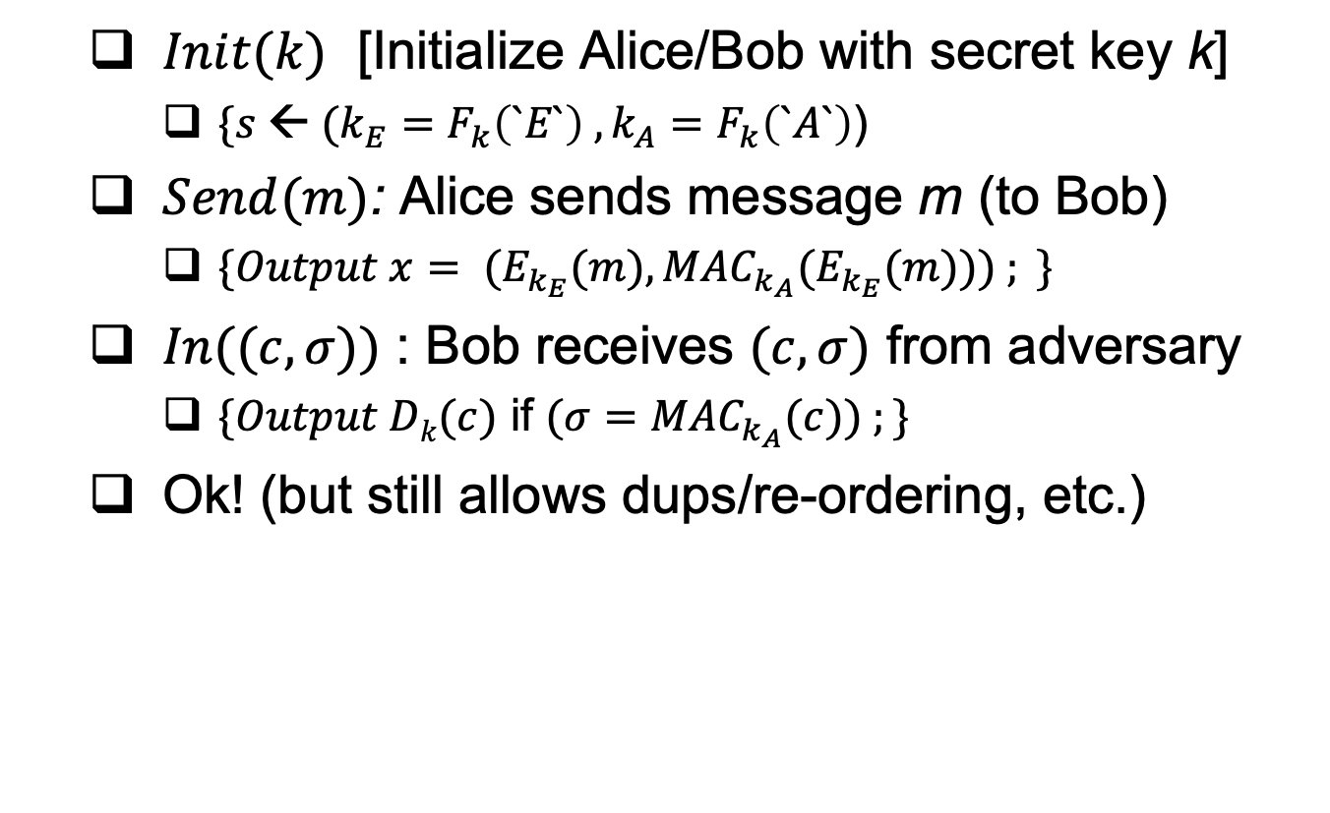
Two-party record protocol with Confidentiality
$Init(k)$ [Initialize Alice/Bob with secret key k]
$\{s ← (k_{E}=F_{k}\left(`E`\right) , k_{A}=F_{k}\left(`A`\right)$)
$Send(m)$: Alice sends message m (to Bob)
$\{Output x= (E_{k_{E}}(m), {MAC}_{k_{A}}(E_{k_{E}}(m))) ; \}$
$In((c,σ))$ : Bob receives $(c,σ)$ from adversary
$\{Output Dk(c)$ if $(σ={MAC}_{k_{A}}(c)) ;\}$
Ok! (but still allows dups/re-ordering, etc.)
12

Slide 13
So, in summary
what does a secure shared-key two-party record protocol mean?
How about the security of the one with confidentially?

Slide 14
Entity Authentication Protocols Ensure the identity of an entity (or a peer) involved in communication.

Slide 15
Mutual Authentication Protocols
Our focus.
In mutual authentication, each party authenticates herself to the other.
Alice knows that she is communicating with Bob, and vice versa
This requires, at least, one exchange of messages.
A message from Alice and a response from Bob (or vice versa).
Such a flow is called a handshake.
15

Slide 16
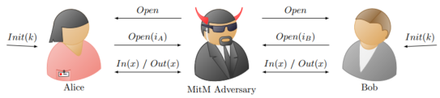
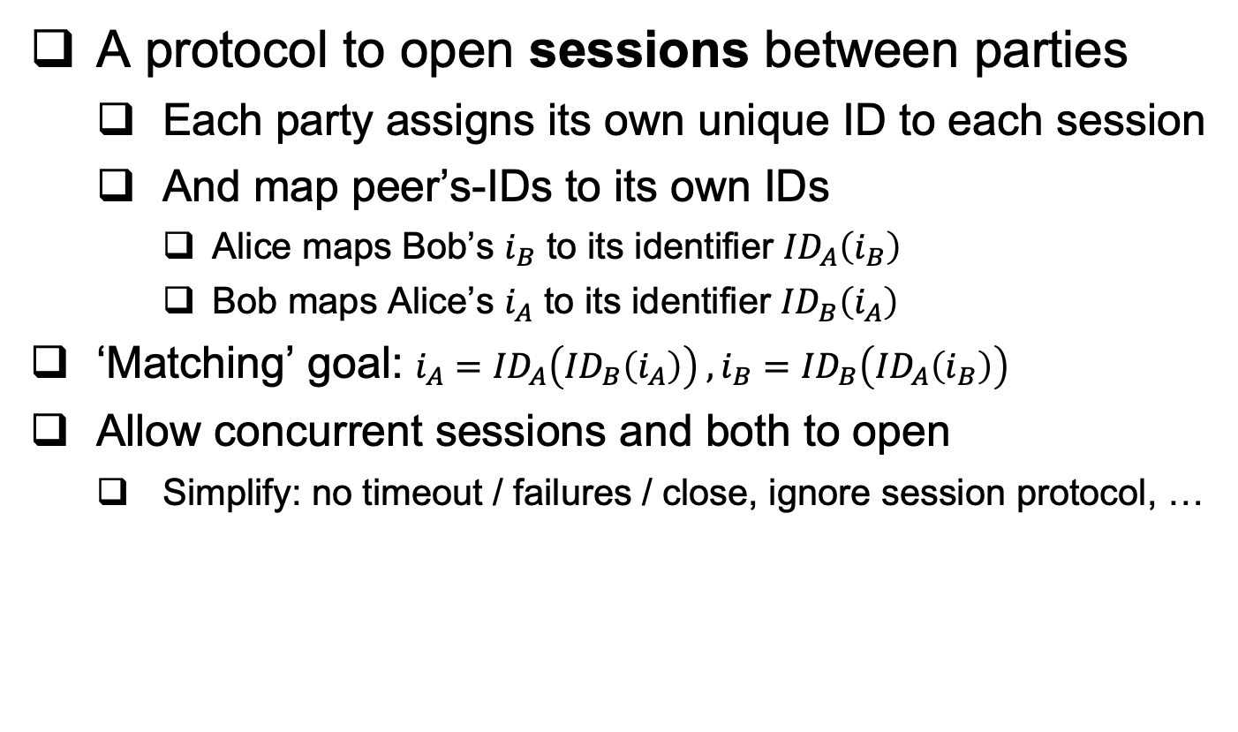
Handshake Entity-Authentication protocol
A protocol to open sessions between parties
Each party assigns its own unique ID to each session
And map peer’s-IDs to its own IDs
Alice maps Bob’s $i_{B}$ to its identifier ${ID}_{A}\left(i_{B}\right)$
Bob maps Alice’s $i_{A}$ to its identifier ${ID}_{B}\left(i_{A}\right)$
‘Matching’ goal: $i_{A}={ID}_{A}\left({ID}_{B}\left(i_{A}\right)\right) ,i_{B}={ID}_{B}\left({ID}_{A}\left(i_{B}\right)\right)$
Allow concurrent sessions and both to open
Simplify: no timeout / failures / close, ignore session protocol, …
16

Slide 17
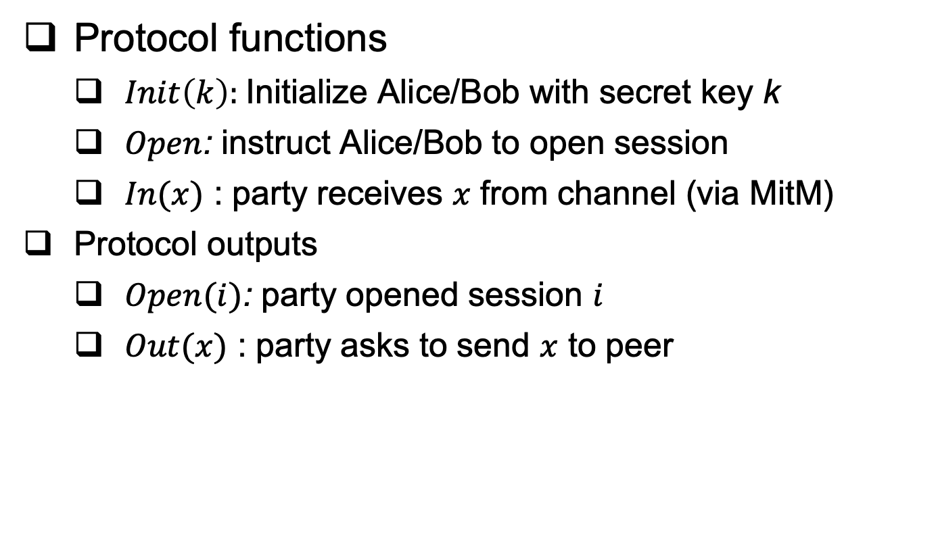
Handshake Entity-Authentication protocol
Protocol functions
$Init\left(k\right):$Initialize Alice/Bob with secret key k
$Open$: instruct Alice/Bob to open session
$In(x)$ : party receives $x$ from channel (via MitM)
Protocol outputs
$Open(i)$: party opened session $i$
$Out(x)$ : party asks to send $x$ to peer
17

Slide 18
Example : IBM’s SNA Handshake
First dominant networking technology
Handshake uses encryption with shared key k
Alice
Bob
A, N_{A}
E_{k}(N_{A}), N_{A} ,N_{B}
N_{B},E_{k}(N_{B})
N_{A} and N_{B} - randomly chosen nonces
Insecure !! Why ?
SNA (Systems Network Architecture): IBM’s proprietary network architecture, dominated market @ [1975-1990s], mainly in banking, government.
18
Notes:
3/30/23
(c) Amir Herzberg, http://AmirHerzberg.com, Bar Ilan University
18
18
(c) Amir Herzberg, http://AmirHerzberg.com, Bar Ilan University
3/30/23

Slide 19
Attack on SNA’s Handshake
MitM opens two sessions with Bob… sending N_{B} to Bob in 2nd connection to get E_{k}(N_{B})
SNA is secure for sequential mutual authentication handshakes but not concurrent.
MitM (spoofing as Alice)
Bob
Session 1
Session 2
Session 1
Session 2
A, N_{A}=1234
E_{k}(1234),N_{B}=5678
5678
A, N_{A}=5678
E_{k}(5678)
E_{k}(5678),N_{B}=9012
E_{k}(5678)
Alice `identified` (spoofed)
19
Notes:
3/30/23
(c) Amir Herzberg, http://AmirHerzberg.com, Bar Ilan University
19
19
(c) Amir Herzberg, http://AmirHerzberg.com, Bar Ilan University
3/30/23
Exercise: fix the protocol (and attack fixes). E.g. why won’t it help if bob sends E_k(N_B) and wait for N_B (instead of sending N_B and waiting for E_k(N_B) ?

Slide 20
Fixing Mutual Authentication
Encryption does not ensure authenticity
Use MAC to authenticate messages
Although, a block cipher is a PRP, and a PRP is a PRF, and a PRF is a MAC, but domain is limited!
Prevent redirection
Identify party in challenge
Better: use separate keys for each direction
Prevent replay and reorder
Identify flow and connection
Prevent use of old challenge: randomness, time or state
Do not provide the adversary with an oracle access!
Do not compute values from Adversary
Include self-chosen nonce in the protected reply
20
Notes:
20
(c) Amir Herzberg, http://AmirHerzberg.com, Bar Ilan University
11/13/11

Slide 21



Two-Party Handshake Protocol (2PP)
A, N_{A}
N_{B} , Mac_{k}(2 || A←B ||N_{A} || N_{B} )
Alice
Mac_{k}(3 || A→B || N_{A} || N_{B} )
Bob
Use MAC rather than encryption to authenticate
Prevent redirection: include identities (A,B)
Prevent replay and reorder:
Nonces (N_{A},N_{B})
Separate 2nd and 3rd flows: 3 vs. 2 input blocks
Secure against arbitrary attacks [proved formally in the literature]
21
Notes:
21
(c) Amir Herzberg, http://AmirHerzberg.com, Bar Ilan University
11/13/11

Slide 22
Covered Material From the Textbook
Chapter 5
Sections 5.1 and 5.2

Slide 23

Thank You!

